Slide 1


OberlinKids PechaKucha Presentation
Notes:
What is asked of us? Help OK figure out how they can reach a wider community within oberlin.
Katherine

Slide 2
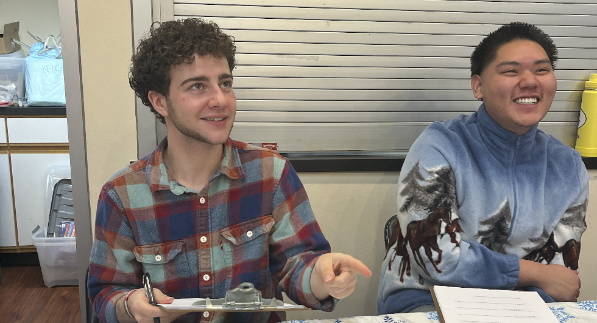
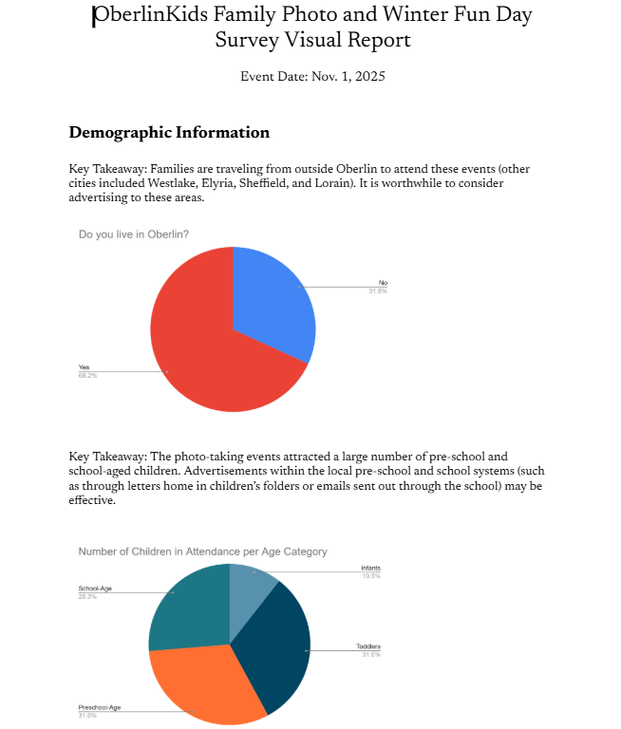
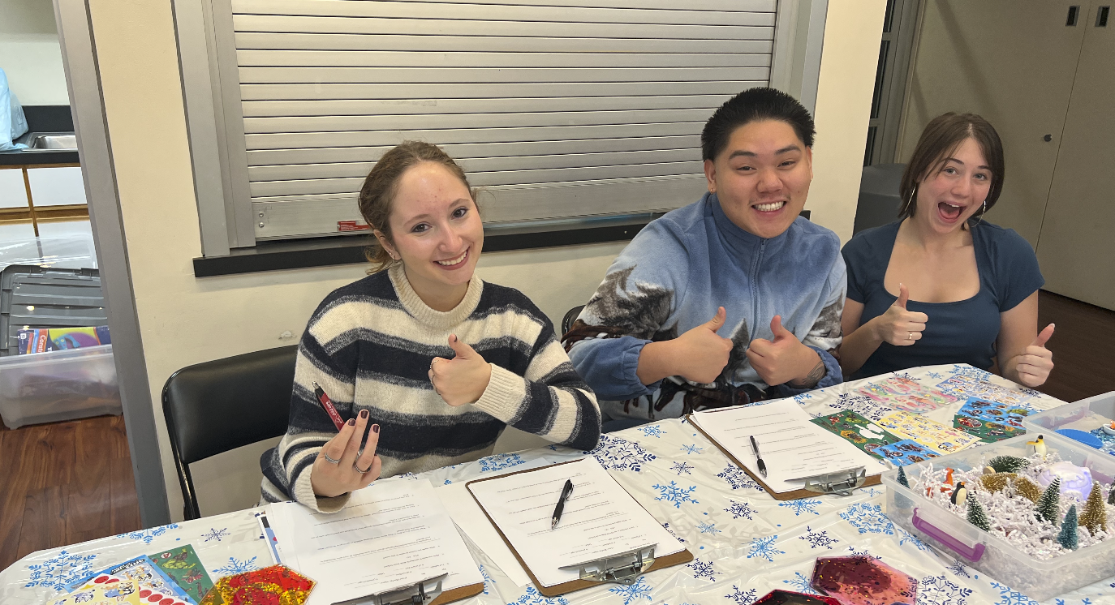
What We've Already Done
Interviews at an Oberlin Kids Photo event
-Surveyed 22 parents
-Created and shared a visual report with our client
Notes:
Jessie + anthony

Slide 3
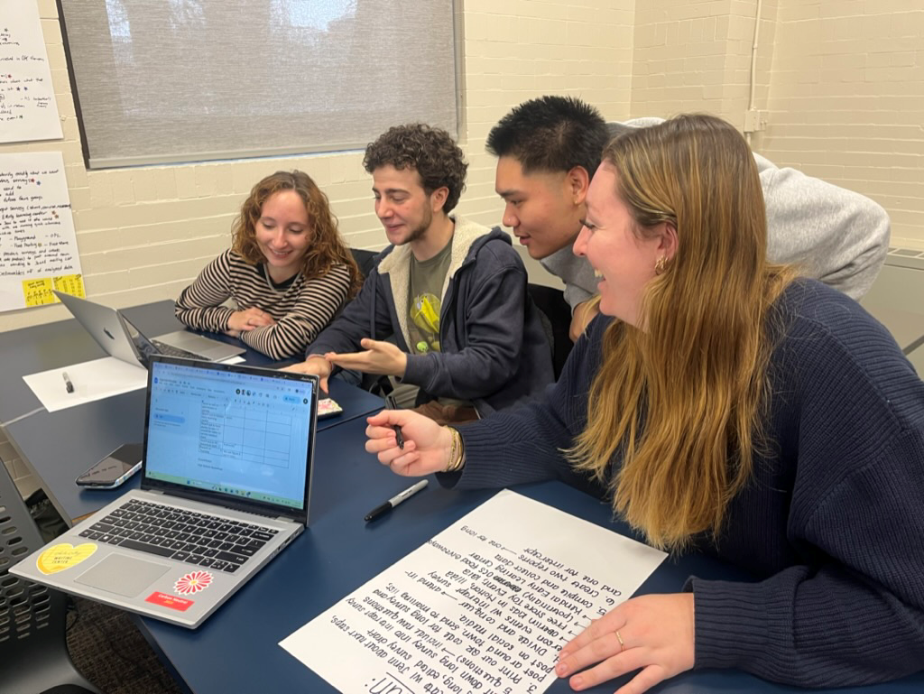
What We Plan To Do
Create 5-minute intercept survey (paper and physical) to reach families not currently or minimally involved with OberlinKids
Attend events with survey (Storytime Fridays, KidsinMotion, Early Learning Center)
Put fliers up with QR code to survey (Oberlin Free Store)
Notes:
Bella

Slide 4

How We Will Present the Information
Visual Report
Video
Notes:
Maya

